Slide 2
Introduction to the Blockchain-Based Shipment Tracking System
The Blockchain-Based Shipment Tracking System is a decentralized solution designed to enhance transparency, security, and efficiency in shipment management.
Key Features
Utilizes blockchain technology to improve tracking processes. Addresses limitations of traditional centralized systems. Aims for a more trustless and secure operation.

Slide 3
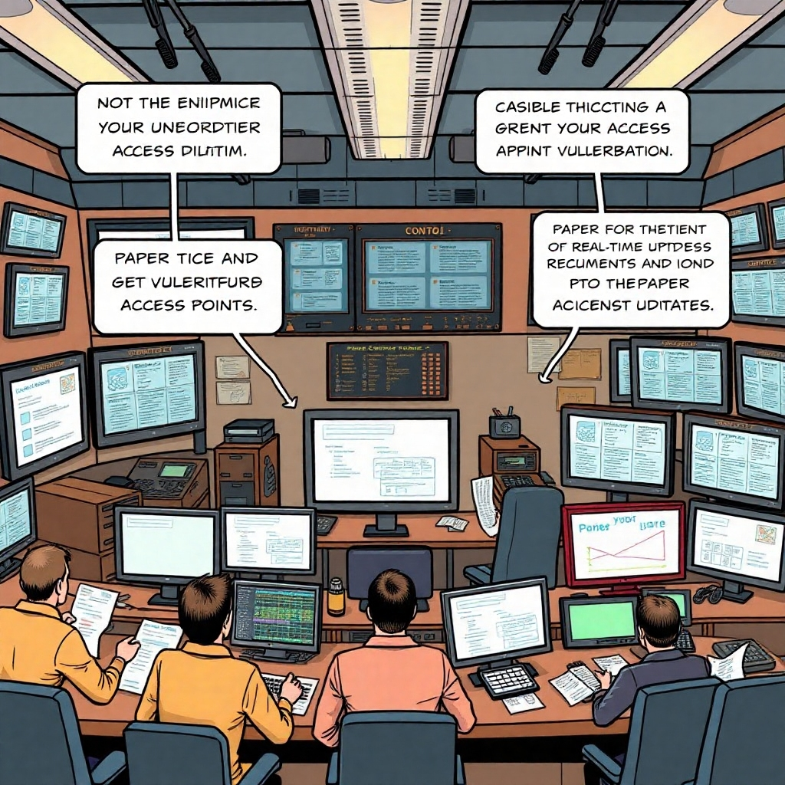
Limitations of Traditional Shipment Tracking
Traditional shipment tracking systems face several significant shortcomings.
Susceptibility to Tampering: Centralized systems are vulnerable to unauthorized changes.
Lack of Real-Time Updates: Delays in information can lead to inefficiencies.
Reliance on Intermediaries: Dependence on third parties can introduce risks and delays.

Slide 4

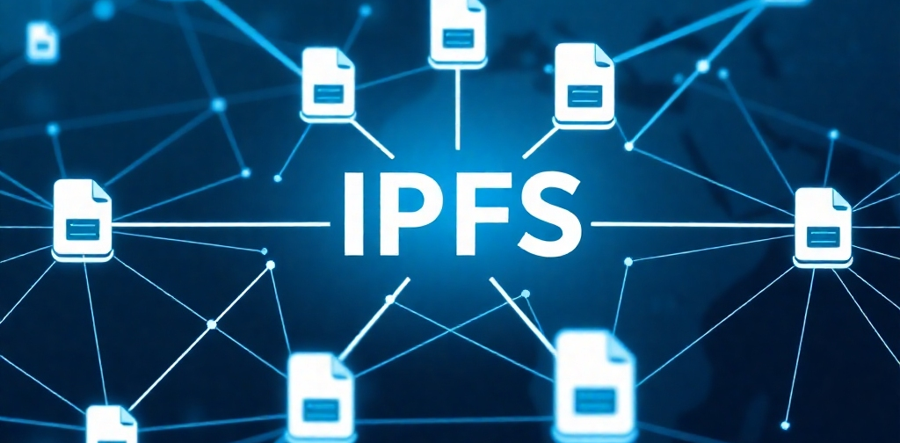

Leveraging Blockchain Technology
Data Immutability
IPFS Integration
Smart Contracts
Data Immutability: Ensures that once data is recorded, it cannot be altered.
IPFS Integration: Provides decentralized storage for persistent data availability.
Smart Contracts: Automate shipment updates, ensuring secure and efficient operations.

Slide 5
Motivation Behind the System Development
Transparency Issues
Need for Automation
Risk of Fraud
Transparency Issues: Lack of visibility in the supply chain.
Need for Automation: Traditional methods often require manual intervention, leading to errors.
Risk of Fraud: Vulnerabilities in centralized systems can lead to fraudulent activities.

Slide 6
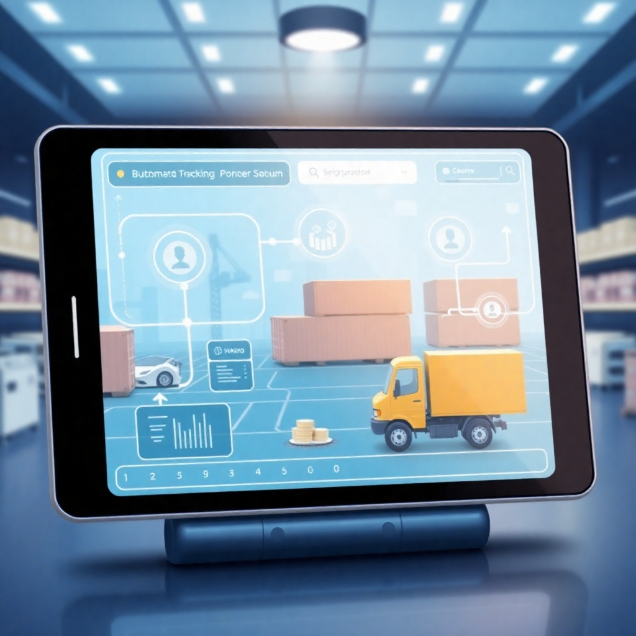
Objectives of the Shipment Tracking System
The primary goal is to develop a robust, scalable, and automated solution.
Integrate blockchain, IoT, and decentralized storage.
Ensure effective shipment tracking through automation.
Provide a user-friendly interface for seamless interaction.

Slide 7

Literature Survey and Identified Gaps
A thorough literature survey reveals significant gaps in existing shipment tracking solutions.
Lack of decentralized solutions in supply chain management.
Insufficient integration of blockchain technology in tracking systems.
Need for improved transparency and security measures.

Slide 8
System Architecture Overview
IoT Sensors
IoT Sensors: Collect real-time data on shipments.
Blockchain Layer
Blockchain Layer: Validates transactions securely.
Storage Layer
Storage Layer: Ensures decentralized data persistence.

Slide 9

Role of Smart Contracts
Smart contracts play a crucial role in automating business logic within the system.
Automated Updates: Facilitate real-time updates of shipment statuses.
Stakeholder Notifications: Notify relevant parties about changes in shipment status.
Enhanced Efficiency: Reduce the need for manual intervention.

Slide 10

Conclusion: Real-World Applications of Blockchain
This project demonstrates the effective application of blockchain technology in addressing real-world challenges.
Enhanced Security: Protects against tampering and fraud.
Increased Transparency: Provides clear visibility into the supply chain.
Automation: Streamlines processes, reducing errors and inefficiencies.
Future Enhancements: Potential for IoT integration and scaling for global supply chains.

